Slide 1
Current Condition
WHY: CAUSE/EFFECTS
HAS:CURRENT CONDITIONS
Anthropogenic and Environmental Factors (+ & -)
Habitat
Demographics
Population
Species
Notes:
Now that we know what the species’ current condition is, [click] we need to explore WHY it is that way.
There are certain CAUSES, or FACTORS, that effect the current condition. (click)

Slide 2
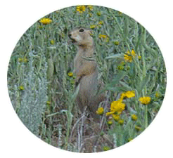
Current Condition
Exposure Path
Source
Project Type
Activity
Component
Stressor
Resource
Stressor
Resource
Consequence Sequence
Stressor
Resource
Cons. Need
Organism Life Stage
Organism Response
Organism Effect
Population Effect
Resource Needs
Activity
Exposure
Biology Deconstruction
Consequences and Determination
Notes:
So, let’s start first with looking at effects to individuals, and then scale up to populations and the species as a whole.
One way to look at this is by building an EFFECTS PATHWAY.
An Activity of some kind CAUSES some environmental change (click). Here, we are calling that the “source”, because it is the source of the change. If the species (or a resource it depends upon) is EXPOSED to that CHANGE (click), it could invoke a behavioral or physiological RESPONSE (click) from the species and have an individual and possibly even population level effect (click).
We call this complete form of the model an Effect Pathway, and it represents a complete chain-of-logic from Cause to Effect in an impact analysis.
Now, if I have these Effects Pathways constructed and THEN I say (click) “building roads kills frogs”, then everybody can see my complete Chain-of-Logic in how I reached that conclusion; And, even better, they can determine which threats are most problematic and what environmental changes could be avoided or minimized to reduce the potential for killing frogs.

Slide 3
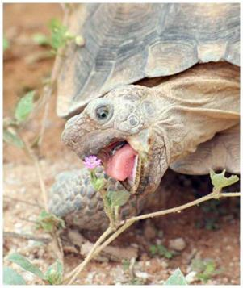
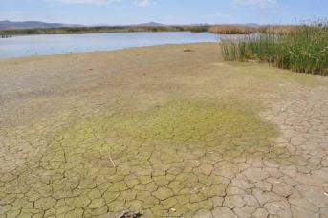
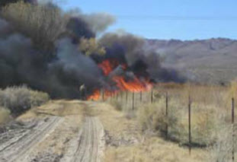
Current Condition
EXPOSED!
Notes:
So, the important question may be, “how are individuals or important habitat resources EXPOSED” (click) to changes that matter to them?
How are the individuals and resources identified in SPECIES NEEDS section EXPOSED to changes in the environment resulting from those anthropogenic and environmental factors?
To answer that question, we first need to discuss STRESSORS.

Slide 4
Current Condition
Any physical, chemical, or biological alteration of resources
(i.e., increase, decrease, or introduction)
that can induce an adverse organism response is called a
STRESSOR
Notes:
Any physical, chemical, or biological ALTERATION of RESOURCES (i.e., increase, decrease, or introduction) (resources are all those things we listed yesterday in the SPECIES NEEDS) that can cause an adverse response by the species is called a [click] STRESSOR.

Slide 5

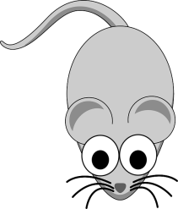
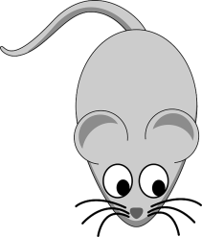
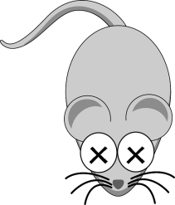
Current Condition
STRESSORS can act directly on an individual, or indirectly through impacts to resources.
Notes:
Stressors can act DIRECTLY [click] on an individual (trauma, crushing, etc.) or INDIRECTLY through impacts to resources.

Slide 6
Current Condition
Based upon this definition, what are some examples of stressors?
Notes:
Ask the class to come up with examples of stressors, and write them on the board or a flip chart (they will be useful later).
The main point is to identify the change in the resource that occurs or the direct impact to the individual.
(It is very important that participants grasp this concept – it will come into play in the exercises, and is the “meeting point” of the chain of logic between the components of the action and how/why the species responds.)
Allow some time to brainstorm examples of stressors before proceeding to the next slide. If they are looking ahead, they will see the ones listed on the next slide, so encourage original thoughts based upon their own project experiences!

Slide 7
Current Condition
Change (resource)
(alteration)
___________________________________________________________
in quality or quantity of
Increase in turbidity (water)
Increase in temperature (climate)
Removal of vegetative cover (plant community)
Introduction of invasive competitors (prey)
Change in microclimate to drier and hotter (climate)
Change in fire regime to more frequent (climate)
Notes:
Examples of stressors. This list, along with the stressors you listed when discussing the previous slide, will be helpful for them to refer back to during Exercise #3.
Recommendation: Make a poster of the definition of STRESSOR and keep the list of stressors that they generated up on the wall (on a marker board or flip chart page).

Slide 8
Current Condition
Change (resource)
(alteration)
___________________________________________________________
in quality or quantity of
Alteration of channel morphology
increasing velocity (water)
Removal of hibernacula (habitat)
Removal of soil (substrate)
Crushing (direct impact)
Vehicle strikes (direct impact)
Notes:
Examples of stressors. This list, along with the stressors you listed when discussing the previous slide, will be helpful for them to refer back to during Exercise #3.
Recommendation: Make a poster of the definition of STRESSOR and keep the list of stressors that they generated up on the wall (on a marker board or flip chart page).

Slide 9
Current Condition
Exposure is
. . . the co-occurrence of :
the species and its resources and
the stressors resulting from an action.
(The more precisely the exposure is described, the better our effects analyses will be.)
Notes:
So when we talk about exposure, we mean how individuals are EXPOSED to the stressors from our action.
The better we describe this relationship, the better our analyses will be.

Slide 10
Current Condition
Exposure analyses are critical because:
We can’t change how a species and critical habitat responds to stressors
We can sometimes change how they are exposed
Conservation measures (BMPs, etc.) can reduce or avoid exposure
Notes:
The Exposure assessment is perhaps the most important step in the analysis process.
Because we can rarely affect how a listed resource will respond to a stressor once exposure occurs, exposure becomes the pivotal point where we have the potential to “solve” the effects issue.
This is why, if you notice, “conservation measures” typically work towards reducing exposure.

Slide 11
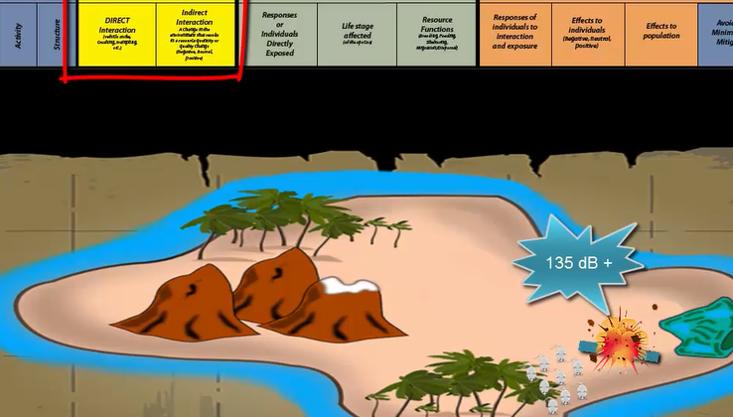
Current Condition
Notes:
The “island mouse” example shows how to create an effect pathway for one subactivity of a proposed project, and reinforces the thought process the students will need to complete the Effects Pathway exercise (next).
Click on image for hyperlink to video.

Slide 12
Current Condition
Activity
Exposure
Biology Deconstruction
Consequences and Determination
Exposure
Which organisms and habitats will be exposed to the stressors?
Response
What happens?
Notes:
We have just descried how our species or resources are EXPOSED (click) to a stressor…
Now, we need to answer, “so, what?” What are the CONSEQUENCES of that exposure? (click)
How do the individuals RESPOND to that exposure to a stressor, and what EFFECT results from that response?

Slide 13
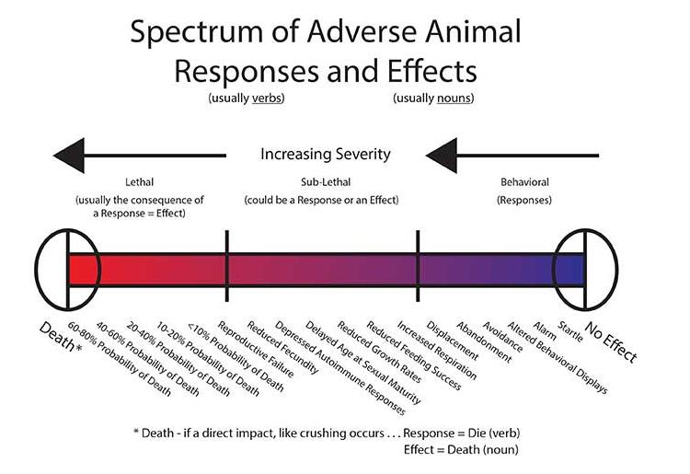
Current Condition
Notes:
This is called the “Spectrum of Adverse Animal Responses”. Note that it focuses on “Adverse” Responses. Remember that beneficial responses can result, too. (What would some of those be?)
When thinking about Response, it can be helpful to consider Response as a continuum, with one side of the continuum representing more moderate responses, such as “avoidance,” and the opposite side representing more severe responses, such as “death.” Another way to think of this is for one side to represent sub-lethal responses and the opposite end representing lethal responses.
This relates to effects to individuals. Where the graph shows, e.g., 40-60% mortality, it means that 40-60% of the individuals exposed will die (i.e., LD₅₀).
So think of it this way…when an individual is exposed to a stressor, WHAT DOES HE DO? Startle? Alarm?, etc… That is the RESPONSE.
The RESPONSE could lead to an EFFECT…

Slide 14
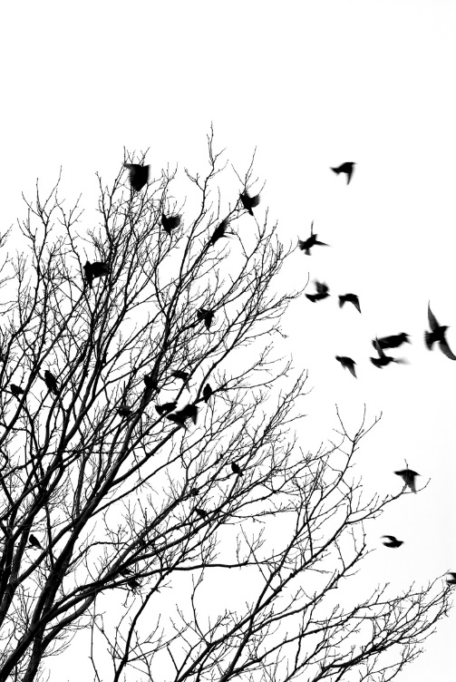
Current Condition
An effect is a consequence of a response to a stressor.
Behavioral responses
Physiological responses
Physical responses
Interactions can be Direct or Indirect
Notes:
An EFFECT is the result of any response from being exposed to a stressor. It is the CONSEQUENCE.
A species response to a stressor can be expressed in any one of a number of ways: (refer to Response Spectrum posters on wall)
Behavioral – alert, startle, flush, flee or avoid (staying away from the stimulus).
Physiological – hormone disruptors in wastewater that impair reproduction or alter the sex of individuals (a physical expression of a physio-change).
Physical – bodily injury; or altering a component or habitat (e.g., removing forage plants).

Slide 15
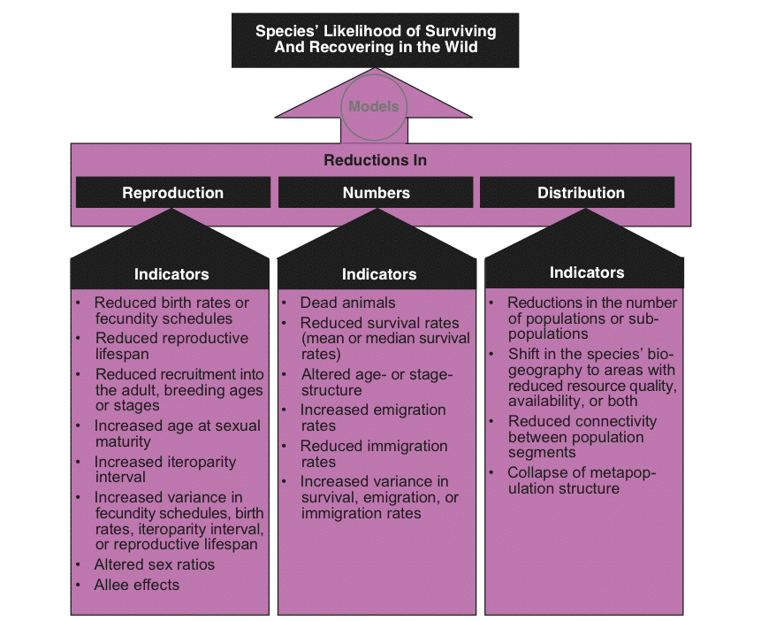
Notes:
These are some CONSEQUENCES, or “indicators” that an effect has occurred. If we see any of these indicators as a result of our activities, that tells us there could be reductions in Reproduction, Numbers, or Distribution.
Remember that we are ultimately evaluating whether the individual responses we identify in our response analyses will have a meaningful effect on the reproduction, numbers, or distribution of the population and species of concern.

Slide 16

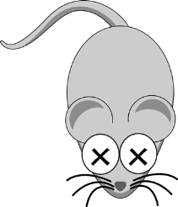

Current Condition
Exposure + Response = Effects
Notes:
In summary, in order to adequately understand the EFFECTS of our actions, we must describe how the species is EXPOSED to a stressor (from our activity) and how the species RESPONDS to that exposure.
Remember that we cannot jump from the threat to a Consequence – “building a road kills frogs”.

Slide 17
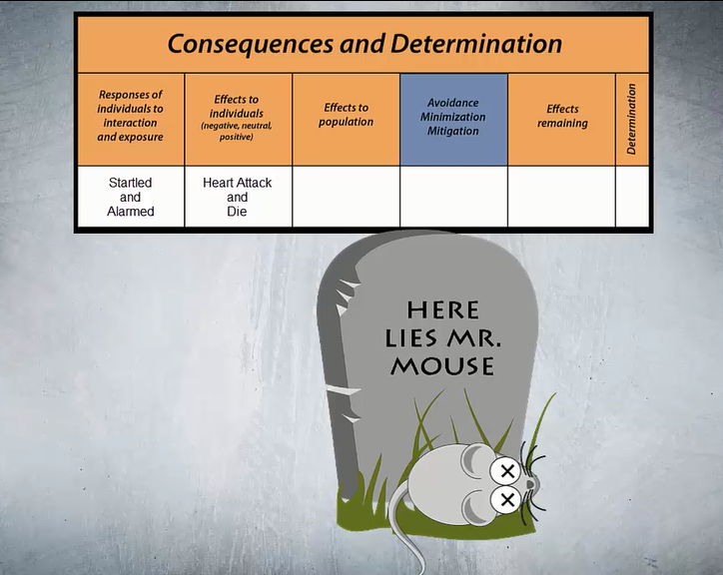
Current Condition
Notes:
This video completes the Effect Pathway for the blasting subactivity example with the island mouse and shows how a work window can be implemented to avoid effects.
CLICK on image for hyperlink to video.

Slide 18


Current Condition
EXERCISE 6. Effects Pathways
Heart attack/death
Reduced numbers
None
Individual mice
Startle/alarm
Work window
Adults
Action Deconstruction |  | Exposure |  | Biology Deconstruction |  |  | Consequences and Determination
Activity | Structure | DIRECT Interaction | Indirect interaction | Resource or Individuals Directly Exposed | Life stage affected | Conservation Functions of the Resource | Responses of individuals to interaction and exposure | Effects to individuals (negative, neutral, positive) | Effects to population | Avoidance Minimization Mitigation | Effects remaining
Notes:
So, to start Exercise 6, let’s first complete the example pathway for the “blasting” activity for the Island Mouse.
The mouse (CLICK) is exposed to increased noise levels from blasting, and his response is startle/alarm (CLICK). In this species, individuals have a heart attack and die when startled (effects to individuals) (CLICK). An increase in death of individuals leads to a population effect – reduced numbers (CLICK). However, if Conservation Actions (CLICK) are added to the action description (that is why this box is BLUE) that can avoid exposure to the stressor (increased noise), you can CHANGE THE EFFECTS! Perhaps this is a migratory mouse species and you will only blast between November and April when they are 20 miles away, therefore, the effects remaining (CLICK) would be NONE (for that exposure to noise).
INSTRUCTOR: Work across the first line of the Effects Pathway Table in Exercise 6 with the class, using the example they just saw in the videos.
Then, create two new pathways for the terminal activity, “walk through habitat”. One row should have a direct interaction (i.e., trampling), and the other should use an indirect interaction (i.e. decrease in shade from trampling vegetation). Work across the Table with those two examples, and then ask the class to do “use heavy construction equipment” (again, one direct and one indirect interaction) individually at their seats. Allow several minutes – and ask a few volunteers to report out. Encourage class to come up with one more completely on their own (the bottom row).

